Slide 1

Independent Jamaica: Politicians and their People 1962-2022
Jacob Moose
Historical Data Management
Final Presentation (Part I)

Slide 2

Question
How do statistics surrounding independent Jamaica’s population change in Election Years? Do different Prime Minister Candidates play a factor?

Slide 3
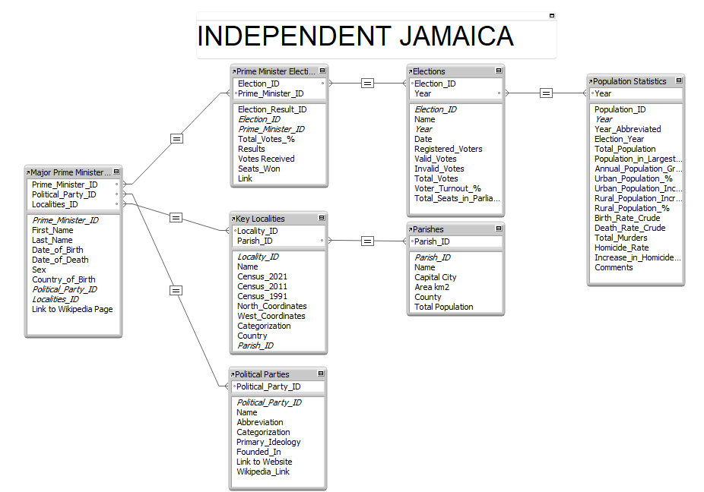
Reading the Relationships

Slide 4
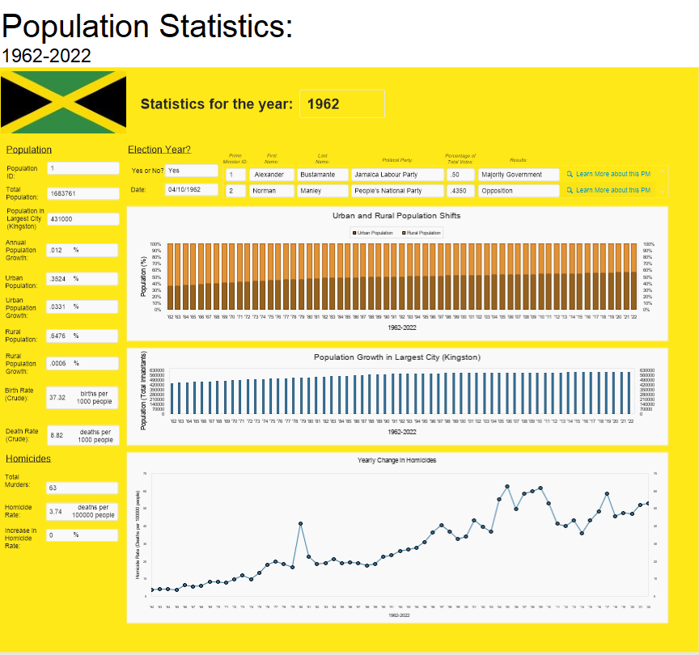
Key Population Statistics:
Annual Growth in Urban Population
Steady Increase following 1962
Annual Growth in Jamaica’s Largest City
Yearly Increase in Homicide Rate
Red Dots represent Election Years
1980 – 150% increase; why?
Do the years before/after elections also play a factor?
Election Year?
Who won in each Election?
Manley vs. Seaga as very contentious period

Slide 5
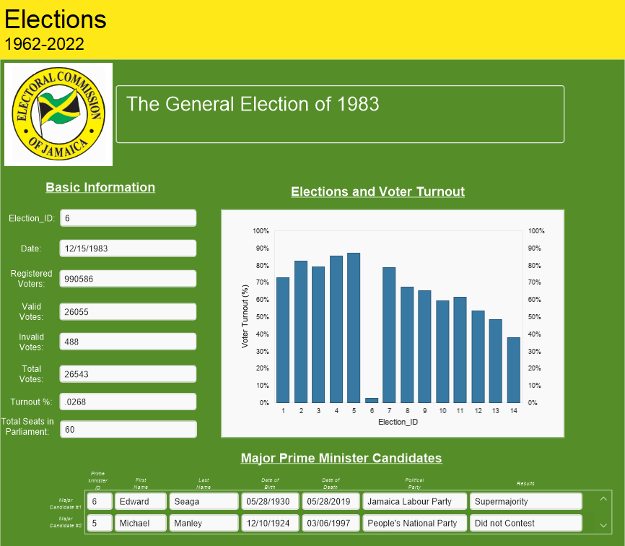
Comparing Population Table with General Elections
1980 – Highest Voter Turnout in Independent Jamaica’s history
Highest Increase in Homicide Rate in the same year
1983 – Why so low?
Manley “Did not Contest”
Decrease in Voter Turnout for (almost) every election after 1980

Slide 6
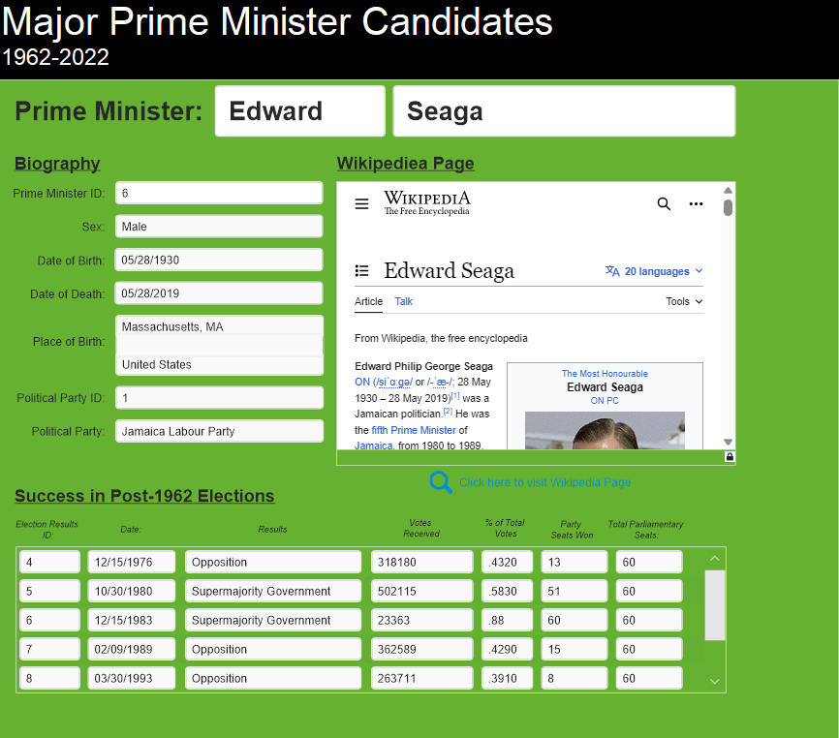
Major Prime Minister Candidates
Portal showing Election Results for each PM
Link to Wikipedia Page
Expanding the Database
Place of Birth (Key Localities, Parish)

Slide 7
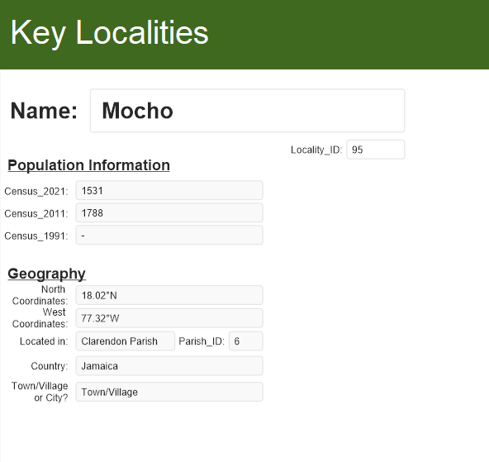
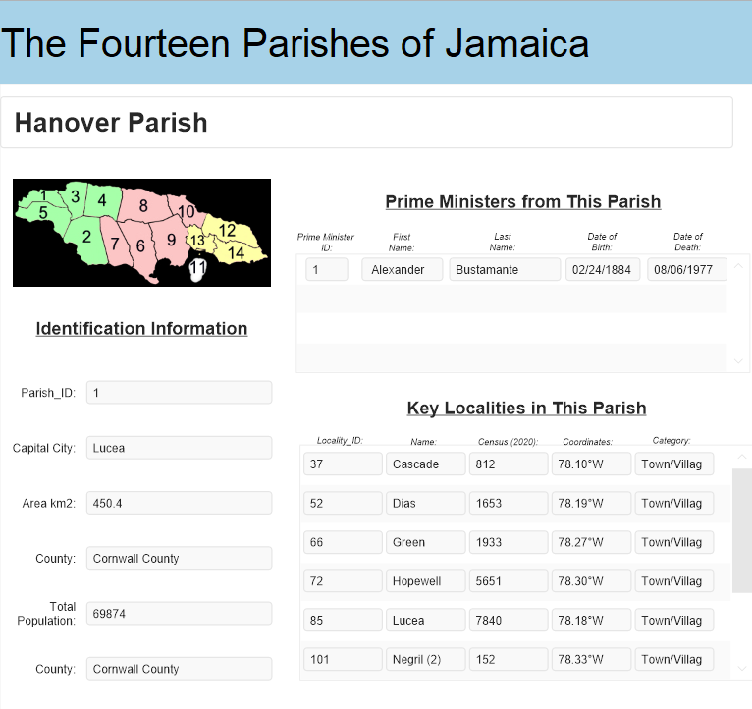
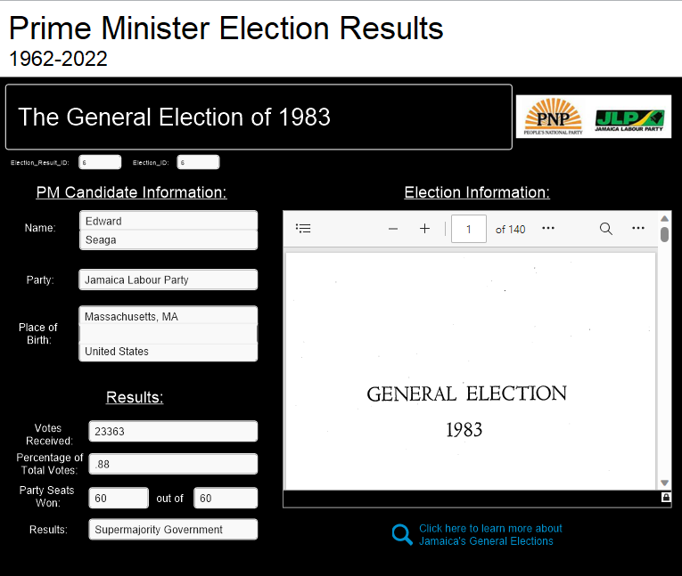
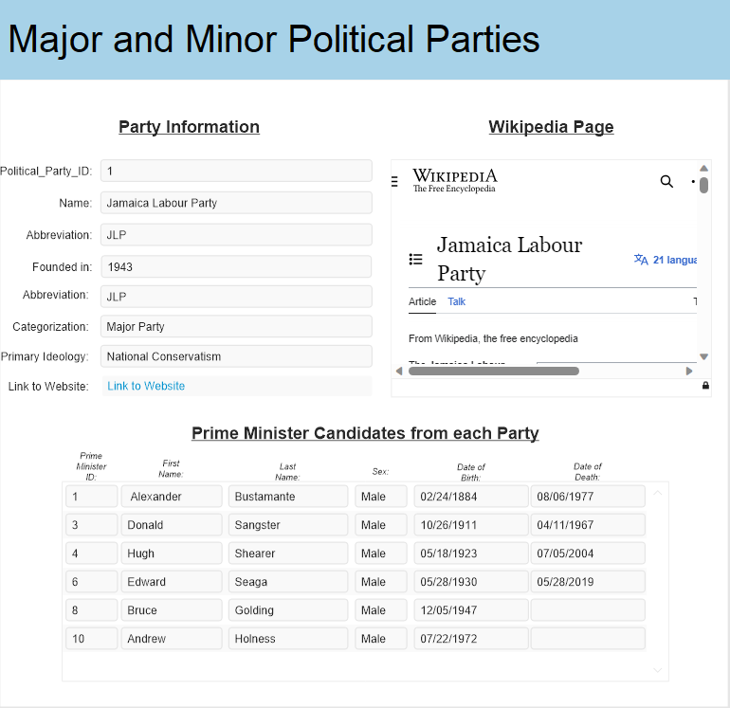
Other Tables

Slide 8


Future of this Database: Jamaica and Late-20th Century Urban Redevelopment

Slide 9
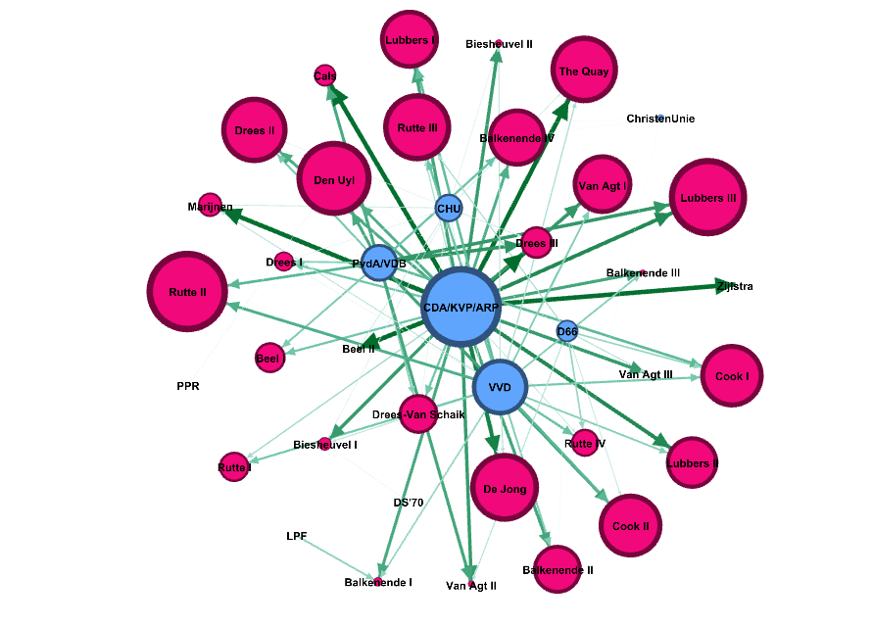
Dutch
Coalition
Governments
1946-2022
Jacob Moose
Historical Data Management
Final Presentation (Part II)

Slide 10

Question
What parties have regularly made-up Dutch coalition governments from 1946 until now? How do party structures changed for Premiers that have led multiple governments?

Slide 11
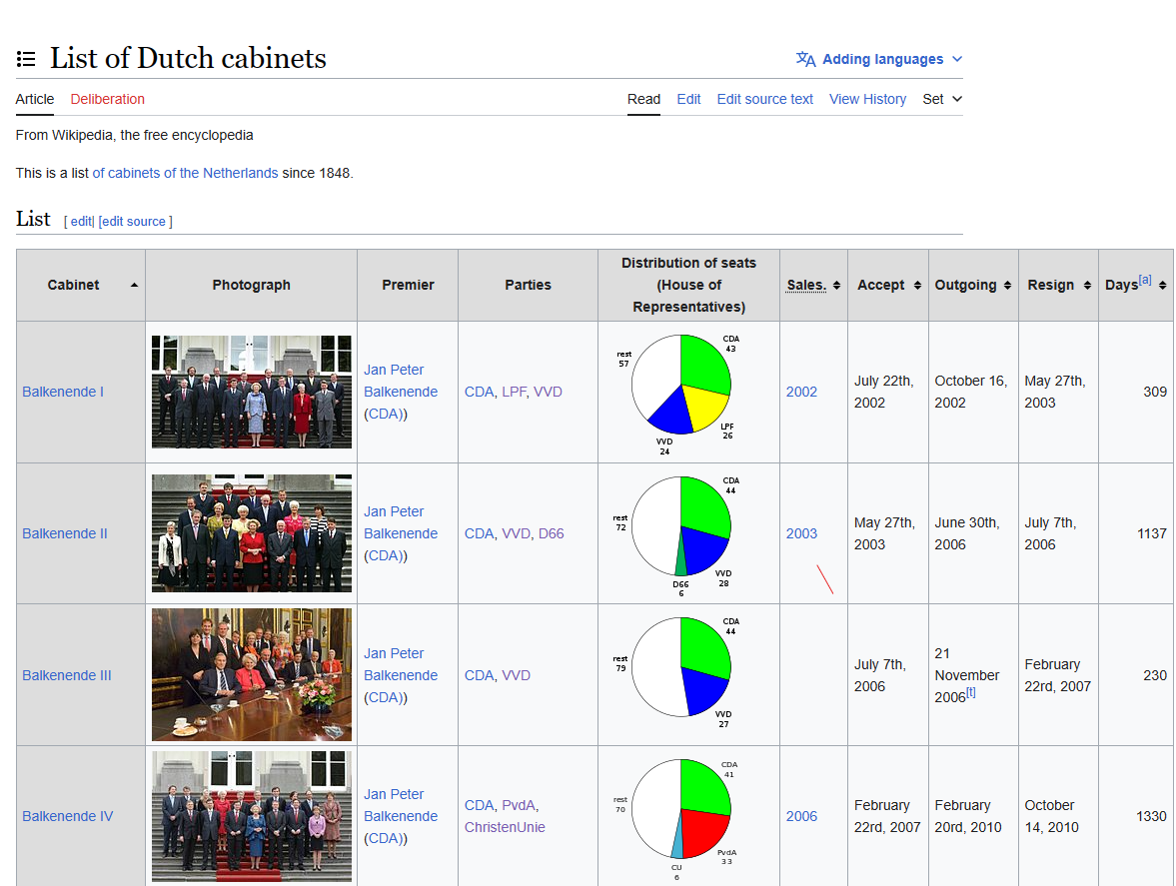
Gathering Data
Key Information
Cabinet Name
Premier Name
Political Parties
Distribution of Seats (House of Representatives)
Days
List of Dutch cabinets - Wikipedia, the free encyclopedia

Slide 12
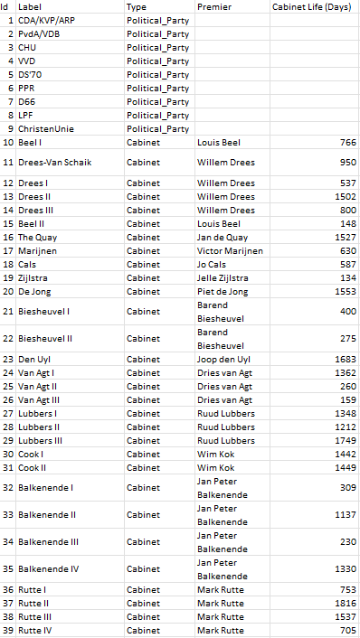
Organizing Nodes (.csv file)
Key Information
ID → specific identification number given to each Node
Label → Name of each Node
Type → I want to represent (2) different types of Nodes in my Network:
Political Parties
Cabinets (i.e., the Government Coalitions)
Premier → Additional attribute for the Coalitions
Cabinet Life (Days) → An additional attribute for the Cabinets*
*Will be important for my Network later
Results
39 Nodes in total
9 for Political Parties
30 for the different cabinets developed since 1946

Slide 13
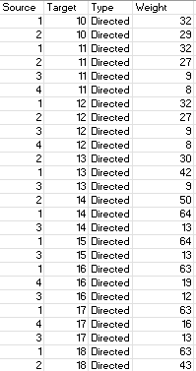
Organizing Edges (.csv file)
Key Information
Source → Associated with Node ID, mainly those that are Political Parties
Target → Associated with Node ID, mainly those that are Cabinets
Type → Directed because Political Parties directly make up the Cabinets (I.e., edges moving in one direction, not both)
Weight → Used to show the Distribution of Political Seats for each of the (named) political parties that make up each Coalition/Cabinet
Results
89 different Edges in total

Slide 14
Visualizing the Data with Gephi
Layout
Fruchterman Reingold
Nodes
Political Parties = Blue
Size based on Degree
Coalition Government = Red
Size based on Cabinet Life (Days)
Edges
Size/Color based on weight (i.e., the number of Parliamentary Seats each named political party held within each Coalition Government
Benefits of this Layout?
Demonstrates the amount of power each political party has held since 1945
It especially highlights the role the CDA/KVP/ARP have played.

Slide 15
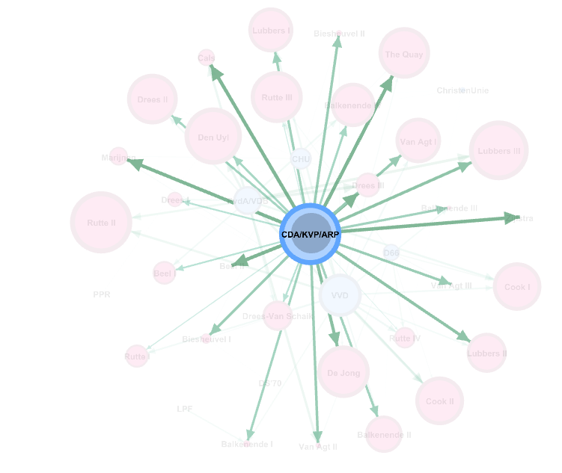
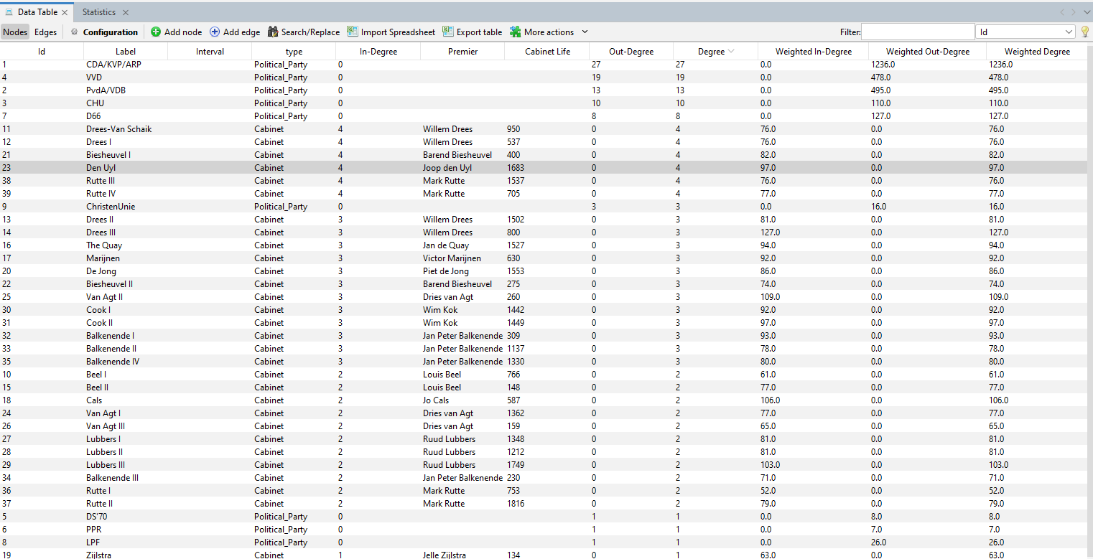
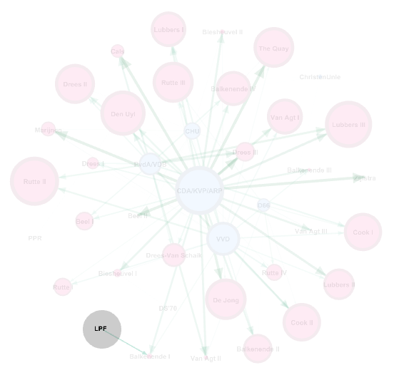





Slide 16
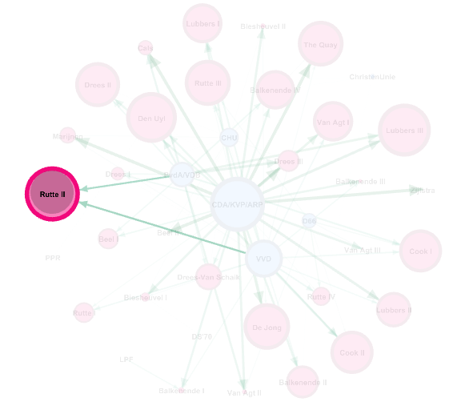
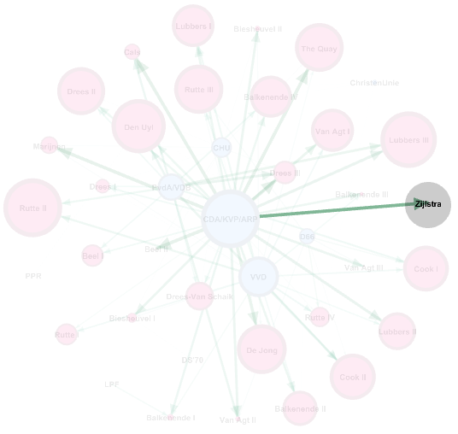

Slide 17
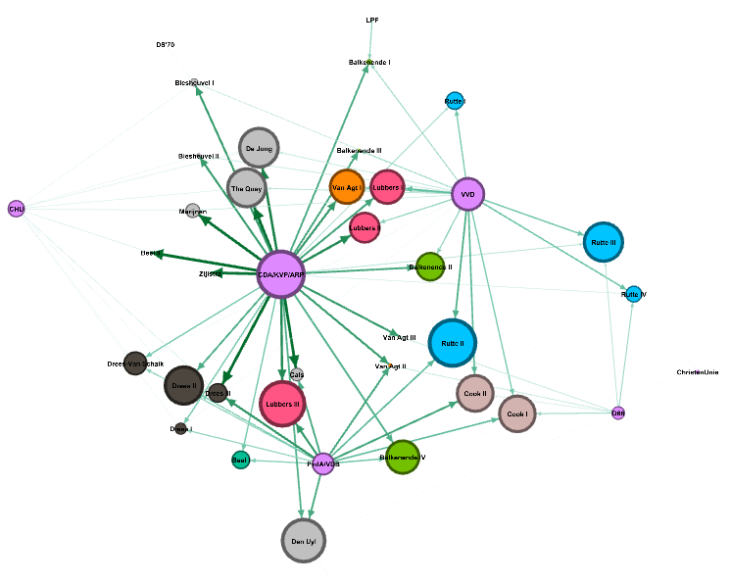
Other Visualizations
Layout
ForceAtlas 2
Nodes
Political Parties = Light Purple
Size based on Degree
Coalition Government = Remaining Colors
Color based on Premier*
*Premier’s who ran only one coalitions are colored light grey
Size based on Cabinet Life (Days)
Edges
Size/Color based on weight (i.e., the number of Parliamentary Seats each named political party held within each Coalition Government)
Benefits of this Layout?
Clearly demonstrates the change in the make-up of each coalition.
More importantly, groupings of colors help show the changes for each Premier

